Slide 1
L08 - Actualization
Initiation
Programmers implement the new functionality
  according to change request
The process of actualization varies
  depends on the size of the change
Concept Location
Impact Analysis
V
E
R
I
F
I
C
A
T
I
O
N
Prefactoring
Actualization
Postfactoring
Conclusion
© 2012 Václav Rajlich Software Engineering: The Current Practice Ch. 8

Slide 2
Small changes
Done directly in old code
class Address
{
public move();
protected String name;
protected String streetAddress;
protected String city;
protected char state[2], zip[5];
};
© 2012 Václav Rajlich Software Engineering: The Current Practice Ch. 8

Slide 3
Small changes
Done directly in old code
class Address
{
public move();
protected String name;
protected String streetAddress;
protected String city;
protected char state[2], zip[9];
};
© 2012 Václav Rajlich Software Engineering: The Current Practice Ch. 8

Slide 4
Small changes
Done directly in old code
class Address
{
public move();
protected String name;
protected String streetAddress;
protected String city;
protected char state[2], zip[9];
};
© 2012 Václav Rajlich Software Engineering: The Current Practice Ch. 8

Slide 5
Larger changes
Programmers implement the new classes separately from the old code
The new code is plugged into the the existing code
  incorporation
The change can propagate to other components of the system
  ripple effect
© 2012 Václav Rajlich Software Engineering: The Current Practice Ch. 8

Slide 6
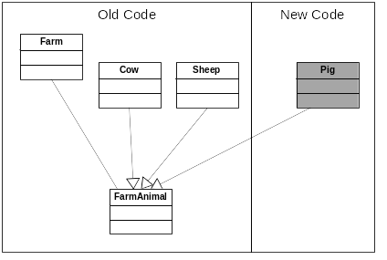
Polymorphism
© 2012 Václav Rajlich Software Engineering: The Current Practice Ch. 8

Slide 7
Polymorphic class
class Pig : public FarmAnimal
{
public:
void makeSound() {cout<<”Oink”;}
};
Farm now can declare objects of the type Cow, Sheep, or Pig
  the composite responsibility of Farm was extended by the concept Pig.
© 2012 Václav Rajlich Software Engineering: The Current Practice Ch. 8

Slide 8
Adding New Component
Implement the new classes separately from the clients in the old code
  new classes assume the responsibilities demanded by the change request
New classes are plugged as components into the appropriate place of the existing code
  incorporation
Change propagation
© 2012 Václav Rajlich Software Engineering: The Current Practice Ch. 8

Slide 9
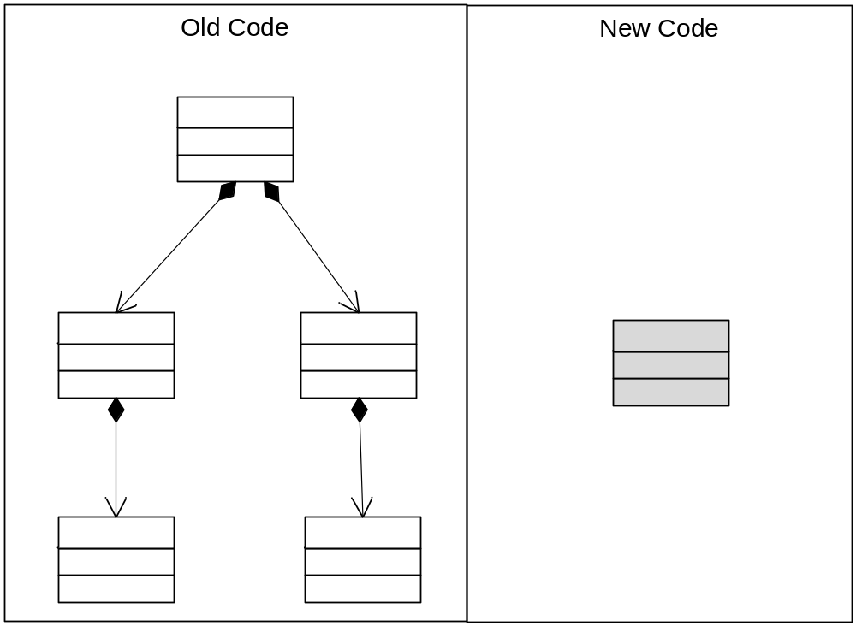
New responsibility is local
© 2012 Václav Rajlich Software Engineering: The Current Practice Ch. 8

Slide 10
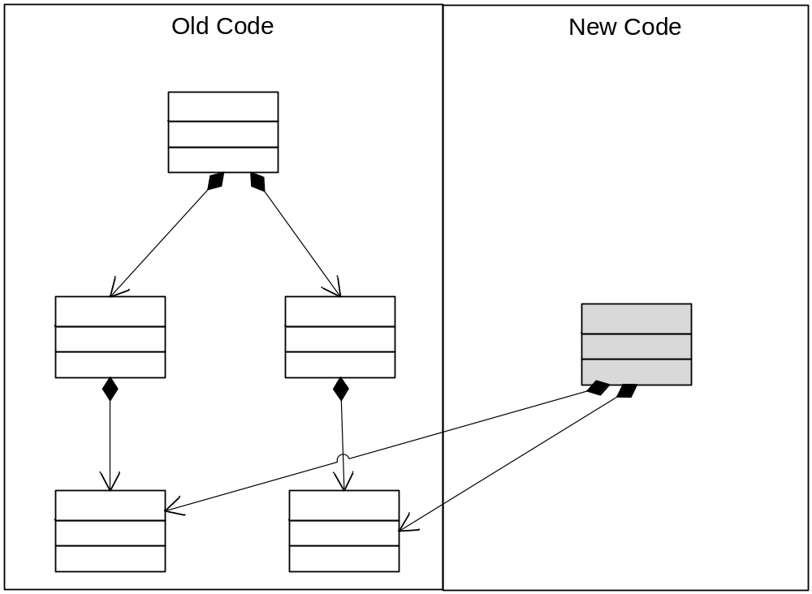
New responsibility is composite
© 2012 Václav Rajlich Software Engineering: The Current Practice Ch. 8

Slide 11

Incorporating new supplier
© 2012 Václav Rajlich Software Engineering: The Current Practice Ch. 8

Slide 12
Point of Sale
The old application did not require authorization
  anyone was able to launch it
The change request:
  “Create a cashier login that will control the user log in with a username and password.”
© 2012 Václav Rajlich Software Engineering: The Current Practice Ch. 8

Slide 13
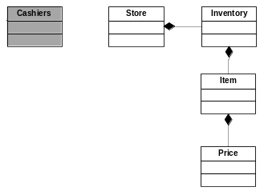
PoS + new class
© 2012 Václav Rajlich Software Engineering: The Current Practice Ch. 8

Slide 14
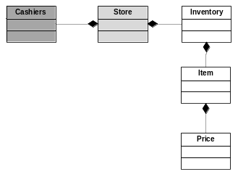
Incorporation of Cashier
© 2012 Václav Rajlich Software Engineering: The Current Practice Ch. 8

Slide 15
Replacement of a class
© 2012 Václav Rajlich Software Engineering: The Current Practice Ch. 8

Slide 16
Example incorporation
register
store
item
sale
saleLineItem
taxCategory
© 2012 Václav Rajlich Software Engineering: The Current Practice Ch. 8

Slide 17
Change propagation
register
store
item
sale
saleLineItem
taxCategory
© 2012 Václav Rajlich Software Engineering: The Current Practice Ch. 8

Slide 18
Change propagation
register
store
item
sale
saleLineItem
taxCategory
© 2012 Václav Rajlich Software Engineering: The Current Practice Ch. 8

Slide 19
Change propagation
register
store
item
sale
saleLineItem
taxCategory
© 2012 Václav Rajlich Software Engineering: The Current Practice Ch. 8

Slide 20
Change propagation
register
store
item
sale
saleLineItem
taxCategory
© 2012 Václav Rajlich Software Engineering: The Current Practice Ch. 8

Slide 21
Change propagation ends
register
store
item
sale
saleLineItem
taxCategory
© 2012 Václav Rajlich Software Engineering: The Current Practice Ch. 8

Slide 22
Deletion of obsolete functionality
Also causes change propagation
All references to the deleted functionality must be deleted
  secondary changes propagate to other classes
© 2012 Václav Rajlich Software Engineering: The Current Practice Ch. 8

Slide 23
Underestimated Impact Set
Impact analysis estimates which classes are impacted
Change propagation modifies the code of impacted classes
  change propagation is the moment of truth
  it confirms or refutes the predictions of impact analysis
  accuracy of impact analysis predictions is important for software managers
© 2012 Václav Rajlich Software Engineering: The Current Practice Ch. 8

Slide 24
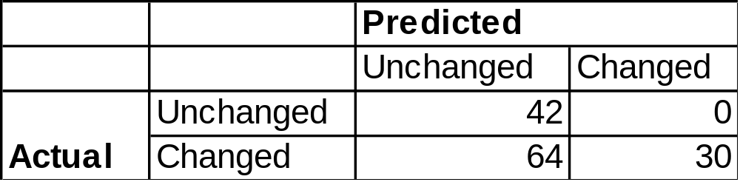
Ericsson Radio Systems
total number of classes =
  42 + 0 + 64 + 30 = 136
© 2012 Václav Rajlich Software Engineering: The Current Practice Ch. 8

Slide 25
Categories
true positives = 30
false positives = 0
true negatives = 42
false negatives = 64
© 2012 Václav Rajlich Software Engineering: The Current Practice Ch. 8

Slide 26
Precision
Used in the information retrieval
Precision = (true positives)/(true positives + false positives)
Ericson, precision = 30/(30 + 0) = 1 = 100%.
© 2012 Václav Rajlich Software Engineering: The Current Practice Ch. 8

Slide 27
Recall
Recall = (true positives)/(true positives + false negatives)
Ericson recall = 30/(30 + 64) = 0.32 = 32%
Programmers estimated that the changes will impact only about a third of all classes that actually changed
  missed the other two thirds!
© 2012 Václav Rajlich Software Engineering: The Current Practice Ch. 8

Slide 28
Underestimation
Common in software engineering
  consequence of invisibility
Makes planning difficult
Common in other field also
© 2012 Václav Rajlich Software Engineering: The Current Practice Ch. 8

